Slide 1
How to :
Data Flow Diagrams (DFDs)

Slide 2
Data Flow Diagrams (DFDs)
Data flow diagram (DFD) is a picture of the movement of data between external entities and the processes and data stores within a system
CUSTOMER
Order
In-Stock Request
WAREHOUSE
Status Message
1.0
Check Status
Shipping Order
Status Data
2.0
Order Data
Shipping Confirmation
Pending Orders
3.0
Issue Status Messages
D1
Generate Shipping Order
Order Data
Payment
4.0
Invoice
Order Data
Manage Accounts
Receivable
5.0
Accounting Data
Accounts Receivable Data
D2
Produce Reports
Accounts Receivable
Inventory Reports
ACCOUNTING

Slide 3
DFD Symbols (Gane & Sarson)
Process
Data Flow Data Store
Source/Sink (External Entity)

Slide 4
Process
1.0
Grade Detail
Grade Report
Produce Grade Report
Work or actions performed on data (inside the system)
Labels should be verb phrases
Receives input data and produces output

Slide 5
Rule 1: Process
Can have more than one outgoing data flow or more than one incoming data flow
1.0
Graded Work
Submitted Work
Grade Student Work
Student Grade
3.0
Hours Worked
Gross Pay
Pay Rate
Calculated Gross Pay

Slide 6
Rule 2: Process
Can connect to any other symbol (including another process symbol)
1.0
2.0
Inventory Change
Order
Accepted Order
Verify Order
Assemble Order

Slide 7
Data Flow
Deposit
Is a path for data to move from one part of the IS to another
Arrows depicting movement of data
Can represent flow between process and data store by two separate arrows
2.1
Payment Detail
D1
Accounts Receivable
Post Payment
Invoice Detail

Slide 8
Data Store
D1
Students
Is used in a DFD to represent data that the system stores
Labels should be noun phrases

Slide 9
Rule: Data Store
Must have at least one incoming and one outgoing data flow
Customer Payment
D1
Daily Payments
Daily Payment

Slide 10
Source/Sink (External Entity)
Order
1.0
CUSTOMER
Invoice
Verify Order
External entity that is origin or destination of data (outside the system)
Is the singular form of a department, outside organisation, other or person
Labels should be noun phrases
Source – Entity that supplies data to the system
Sink – Entity that receives data from the system

Slide 11
Rule: Source/Sink
Must be connected to a process by a data flow
BANK
Bank Deposit
2.0
Prepare Deposit

Slide 12
Rules for Using DFD Symbols
Data Flow That Connects
YES NO
A process to another process
A process to an external entity
A process to a data store
An external entity to another external entity
An external entity to a data store
A data store to another data store

Slide 13
Context Diagram
Top-level view
Shows the system boundaries, external entities that interact with the system, and major information flows between entities and the system.
Example: Order system that a company uses to enter orders and apply payments against a customer’s balance

Slide 14
Context Diagram of Order System
Order
WAREHOUSE
CUSTOMER
Order Reject Notice
Picking List
Payment
Invoice
0
Completed Order
Order System
Commission
Bank Deposit
Cash Receipts Entry
SALES REP
ACCOUNTING
BANK

Slide 15
Level-0 DFD
Shows the system’s major processes, data flows, and data stores at a high level of abstraction
When the Context Diagram is expanded into DFD level-0, all the connections that flow into and out of process 0 needs to be retained.

Slide 16
Context Diagram of Order System
Order
WAREHOUSE
CUSTOMER
Order Reject Notice
Picking List
Payment
Invoice
0
Completed Order
Order System
Commission
Bank Deposit
Cash Receipts Entry
SALES REP
ACCOUNTING
BANK

Slide 17
CUSTOMER
Order
Picking List
WAREHOUSE
Level-0 DFD of Order System
1.0
Fill Order
Order Reject Notice
Invoice
2.0
Payment
Invoice
Create Invoice
Completed Order
D1 | Accounts Receivable
Payment Detail |  | Invoice Detail
3.0
Apply Payment
Commission
Bank Deposit
Cash Receipts Entry
SALES REP
BANK
ACCOUNTING

Slide 18
Lower-Level Diagrams
Functional Decomposition
An iterative process of breaking a system description down into finer and finer detail
Uses a series of increasingly detailed DFDs
Balancing
The conservation of inputs and outputs to a data flow process when that process is decomposed to a lower level
Ensures that the input and output data flows of the parent DFD are maintained on the child DFD

Slide 19
Strategies for Developing DFDs
Top-down strategy
Create the high-level diagrams (Context Diagram), then low-level diagrams (Level-0 diagram), and so on
Bottom-up strategy
Create the low-level diagrams, then higher- level diagrams

Slide 20
Identify Entities,Process,Data Stores & Data Flow
Entities
Customer
Warehouse
Accounting
Processes
1.0 Check Status
2.0 Issue Status Messages
3.0 Generate Shipping Order
4.0 Manage Accounts Receivable
5.0 Produce Reports
Data Stores
D1 Pending Orders
D2 Accounts Receivable
Data Flows
Order
In-Stock Request
Order Data
Status Data
Status Message
Shipping Order
Order Data
Invoice
1.0
■
2.0
3.0
Shipping Confirmation
Payment
Accounting Data
4.0
■
Accounts Receivable Data
Order Data
Inventory Reports
5.0

Slide 21
CUSTOMER
Order
WAREHOUSE
In-Stock Request
Payment
Status
0
Shipping
Message
Order
Order System
Invoice
Shipping Confirmation
Inventory Reports
ACCOUNTING
Context Diagram of Order System

Slide 22
CUSTOMER
Order
In-Stock Request
WAREHOUSE
Status Message
1.0
Check Status
Shipping Order
Status Data
2.0
Order Data
Shipping Confirmation
D1
Pending Orders
3.0
Issue Status Messages
Generate Shipping Order
Order Data
Payment
4.0
Invoice
Order Data
Manage Accounts Receivable
5.0
Accounting Data
Accounts Receivable Data
Produce Reports
D2
Accounts Receivable
Inventory Reports
Level-0 of Order System
ACCOUNTING

Slide 23
Decomposition of DFDs
Functional Decomposition
iterative process of breaking down the description of a system into finer and finer detail
keep going until point where process can no longer be logically broken down
creates a series of exploding charts
Level-n diagram

Slide 24

Creating Data Flow Diagrams
Example
Create a list of activities
Group these activities in some logical fashion, possibly functional areas.
Customer Order
Serve Product
Collect Payment
Produce Product
Store Product
Order Raw Materials
Pay for Raw Materials
Pay for Labor

Slide 25







Example
1.0
Sale
1.1
Record Order
1.2
Receive Payment
2.0
Production
2.1
Serve Product
2.2
Produce Product
2.3
Store
Product
0.0
Lemonade System
3.0
Procure-ment
3.1
Produce Purchase Order
3.2
Receive Items
3.3
Pay Vendor
4.0
Payroll
4.1
Record Time Worked
4.2
Calculate Payroll
4.3
Pay Employee
Context Level
Level 0
Level 1

Slide 26
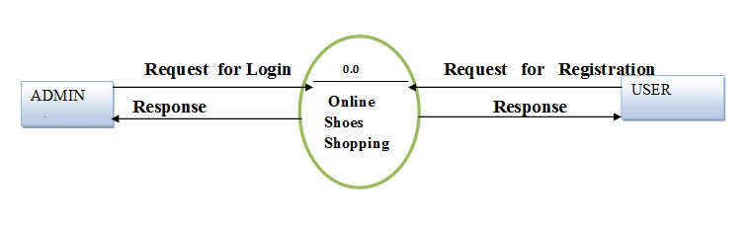

Slide 27
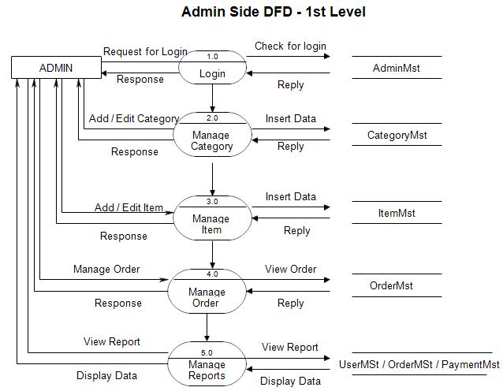

Slide 28
